Slide 1


Presented by Praveen M

Slide 2
Context
Our company
Atliq Hardware one of the leading computer hardware producers in India..
Background
The management noticed that they do not get enough insights to make quick and smart data-informed decisions
Problem
There are 10 hoc request for which the company needs insight
Approach
Run a SQL query to answer these request. Convert it into Visualization and present the insight to the top level management or Product owner

Slide 3
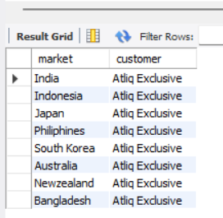
Request:
Provide the of markets in which customer “Atliq Excusive” operates its business the APAC region…..
Output
1

Slide 4
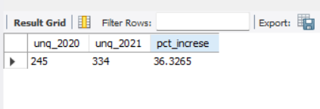
That 89 new product have been included in the inventory for the 2021 fiscal year the percentage of rise in 36.33
Request:2
2
output

Slide 5
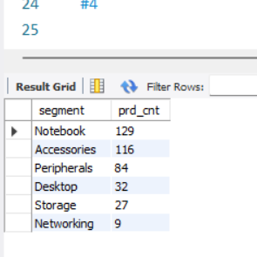
Request:3
3.Provide a Report with all the unique product count for each segment sort them in descending order of product count output:
Segment
Product count
output
3

Slide 6
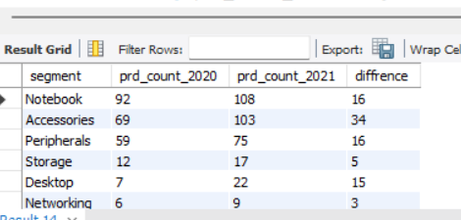
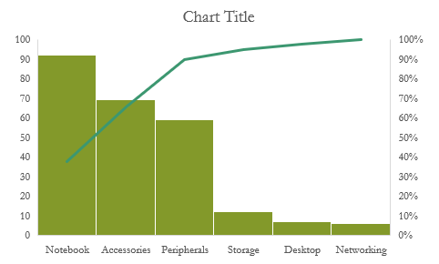
Insights;
4. In the fiscal year of 2021 most new product have been included in the accessories segment with 34 products……..
output
4

Slide 7
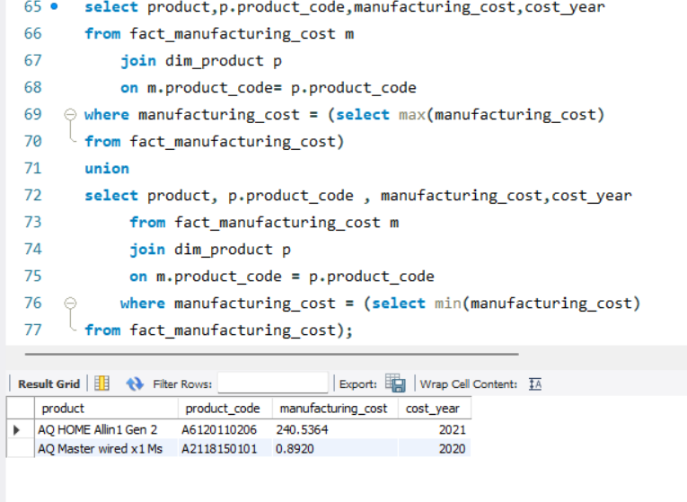
AQ Home Allin 1 gen 2 Product code : A6120110206 has highest manufacturing cost of $ 240.53
AQ master wired
x1Ms product code: 2118150101 has the lowest manufacturing cost of $ 0.89..
Output
Insights
5
240.5
0.892
2021
2020

Slide 8
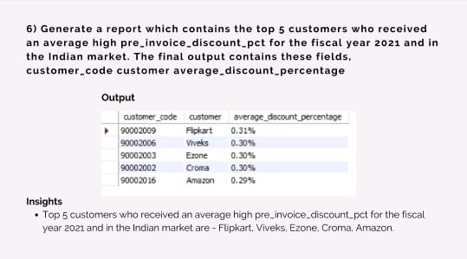
Flipkart is highest average discount percentage 0.3803
Output
6

Slide 9
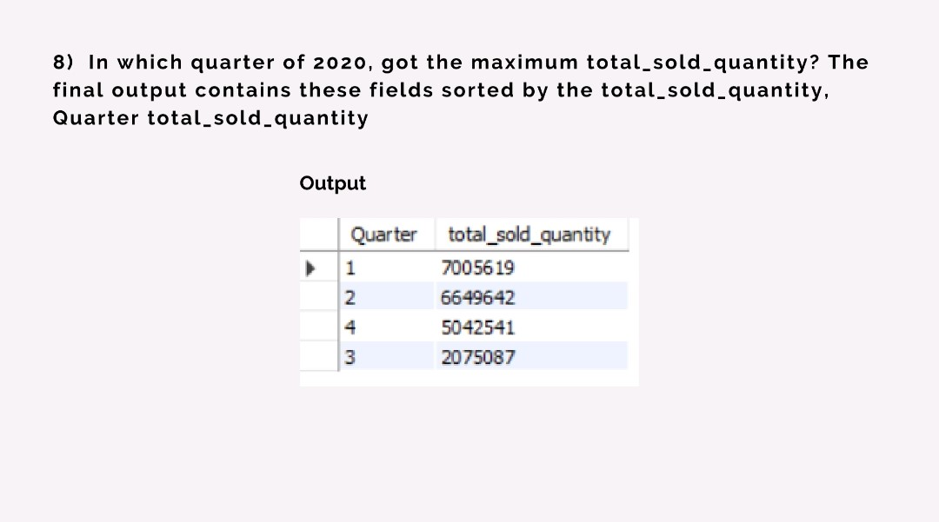
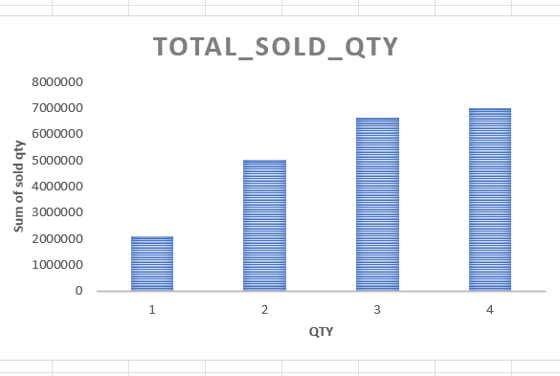
In which first quarter of the fiscal year 2020 maximum quantity has been sold with 7.01M Sold Quantity
output
7.0M
7
6.6M
5.0M
2.1M

Slide 10
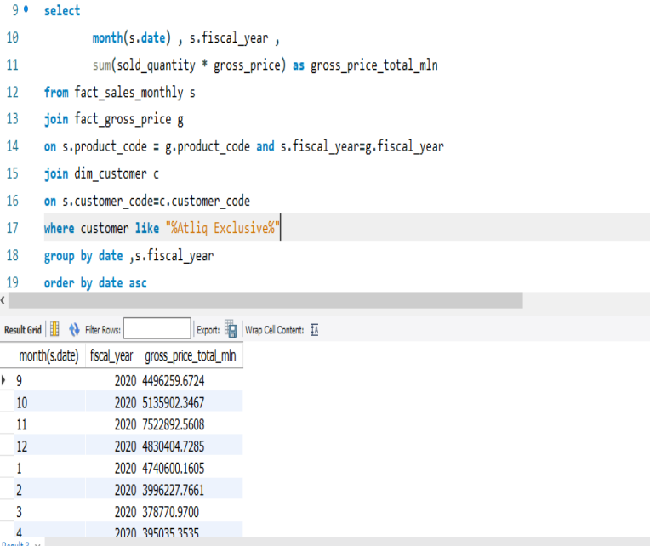
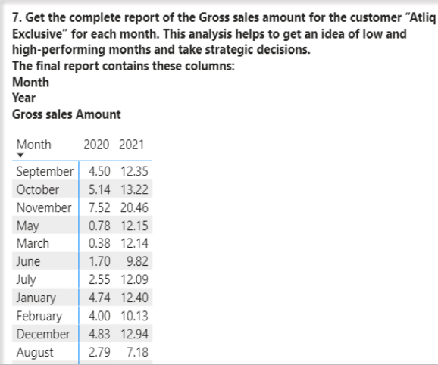
8

Slide 11
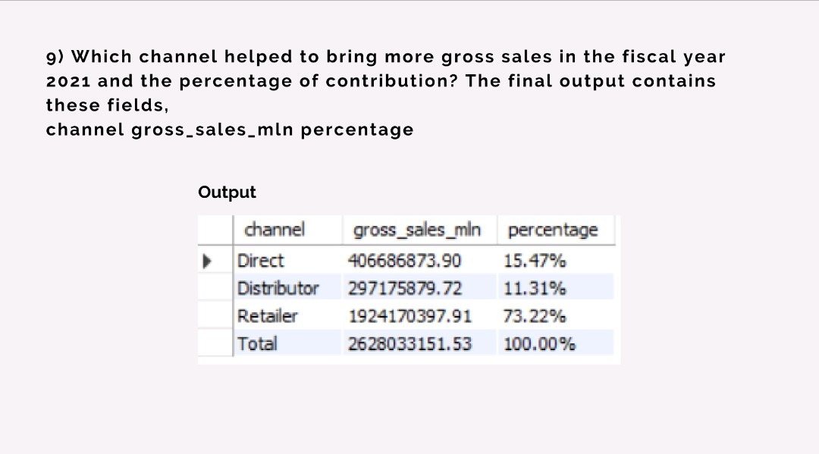
The retailer channel has more gross sales at 73.22%
Output
9

Slide 12
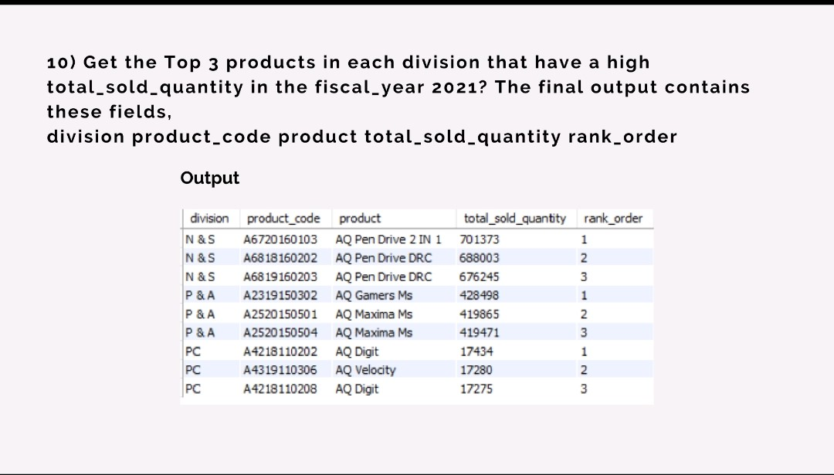
AQ pen drive 2 in 1(N and S)AQ Gamers Ms(P and A) Digit PC these or product or most sold quantity in each division
output
10

